Slide 1

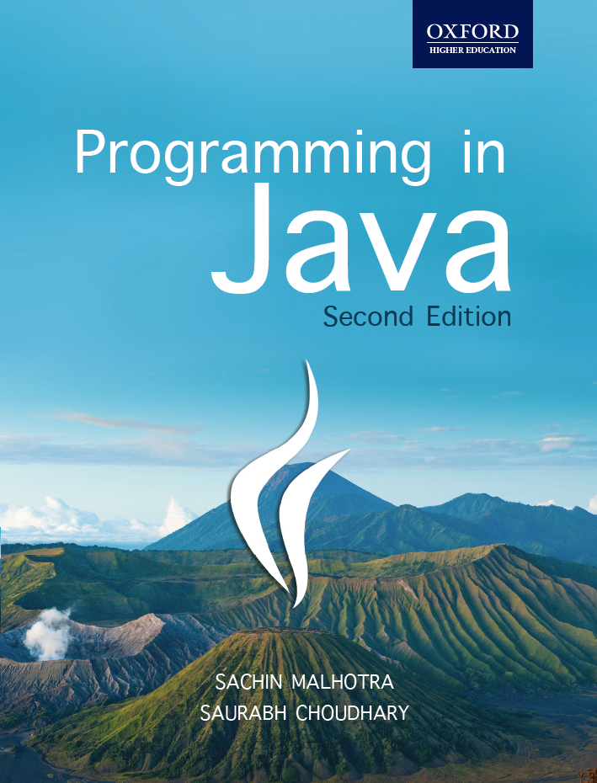
Programming in Java, 2e
Sachin Malhotra
Saurabh Choudhary

Slide 2
Chapter 4
Classes and Objects

Slide 3
OBJECTIVES
Know how classes & Objects are created and applied in java
Know how methods are created and used.
Understand polymorphism concepts: Overloading
Understand what is a Constructors
Establish familiarity with static and this keyword.
Know about Arrays & command line arguments.
understand inner classes

Slide 4
Classes and Objects
A class is a blueprint or prototype that defines the variables and methods common to all objects of a certain kind.
Class can be thought of as a user defined data type and an object as a variable of that data type, which can contain data and methods i.e. functions, working on that data.
All object instances have their own copies of instance variable.
Each object has its own copy of instance variables which is different from other objects created out of the same class.

Slide 5
How to declare Class in JAVA?
A class is declared using class keyword followed by the name of the class.
Syntax of declaration of class
class classname {
//Variables declaration
//Methods declaration
}
Example
class GoodbyeWorld { public static void main (String args[]) { System.out.println("Goodbye World!"); }}

Slide 6
Declaring classes in Java
The class declaration can specify more about the class like you can:
declare what the class's superclass (discussed in chapter 5)
list the interfaces implemented by the class (discussed in chapter 6)
declare whether the class is public, abstract,( discussed in chapter 6) or final (discussed in chapter 5)
Summary of class declaration syntax as;
[modifiers] class ClassName [ extends SuperClassName ] [ implements InterfaceNames ] {
…………
}

Slide 7
Declaring classes in Java (contd.)
The items between [ and ] are optional. A class declaration defines the following aspects of the class:
modifiers declare whether the class is public, protected, default, abstract, or final
ClassName sets the name of the class you are declaring
SuperClassName is the name of ClassName's superclass
InterfaceNames is a comma-delimited list of the interfaces implemented by ClassName
The Java compiler assumes the class to be non-final, non-public, non-abstract, subclass of Object (chapter 6) that implements no interfaces if no explicit declaration is specified.

Slide 8
Parts of a class
The class contains two different sections: variable declarations and method declaration. The variables of a class describe its state and methods describe its behavior.
classDeclaration {
memberVariableDeclarations
methodDeclarations
}

Slide 9
Example
Class SalesTaxCalculator for calculating and displaying the tax
class SalesTaxCalculator {
float amount=100.0f;
float taxRate=10.2f;
void calculateTax() {
float taxAmt = amount*taxRate/100;
System.out.println(taxAmt);
}
}

Slide 10
Objects
The real-world objects have state and behavior.
For example,
horses have state (name, color, breed, hungry) and horses have behavior (barking, fetching, and slobbering on your newly cleaned slacks).
Bikes have state (gear, accelerator, two wheels, number of gears, brakes) and behavior (braking, accelerating, slowing down and changing gears).
An object is a software bundle which encapsulates variables and methods, operating on those variables.

Slide 11
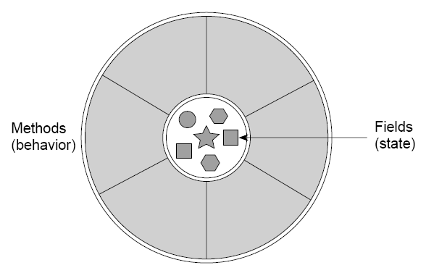
Why should we use classes and objects
Modularity and information hiding i.e. data encapsulation can be incorporated using an object, in software. Classes, being blueprints, provide the benefit of reusability.

Slide 12
Creating Objects
Java object created with a statement like this one:
SalesTaxCalculator obj1 = new SalesTaxCalculator ( );
This statement creates a new SalesTaxCalculator object.
This single statement declares, instantiates, and initializes the object.

Slide 13
Declaring an Object
object declarations is same as variable declarations for e.g.
SalesTaxCalculator obj1;
Generally the declaration is as follows:
type name;
Where type is the type of the object (i.e. class name) and name is the name of the reference variable used to refer the object
Difference between variables and objects:
A variable holds a single type of literal, while an
object is a instance of a class with a set of instance variables and methods which performs certain task depending what methods have been defined for .

Slide 14
Initializing an object
By initializing an object we mean that the instances variables are assigned some values. This task is accomplished using a constructor.
The final object creation can be said as complete when the objects are initialized, either with an implicit constructor or an explicit constructor. This object creation can be used in programming code in two ways:
SalesTaxCalculator obj1 = new SalesTaxCalculator ( );
Here all the three operations, object declaration, object instantiation and object initialization are done by one statement only.

Slide 15
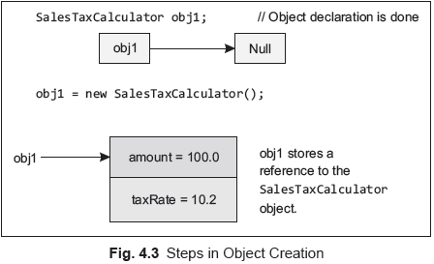
Initializing an object
The above process actually takes place in following way:

Slide 16
Instance Variable
A class can have many instances, each instance having its own set of variables. E.g.
class SalesTaxCalculator {
float amount=100.0f; // instance variable
float taxRate=10.2f; //instance variable
void calculateTax() {
float taxAmt = amount*taxRate/100;
System.out.println(taxAmt); }
public static void main (String args[ ]) {
SalesTaxCalculator obj1 = new SalesTaxCalculator();
SalesTaxCalculator obj2 = new SalesTaxCalculator();
System.out.println("Amount in Object 1: "+ obj1.amount);
System.out.println("Tax Rate in Object 1: "+ obj1.taxRate);
System.out.println("Amount in Object 2: "+ obj2.amount);
System.out.println("Tax Rate in Object 2: "+ obj2.taxRate);
}}

Slide 17
Instance variable (contd.)
Each variable declared inside a class and outside the methods is termed as instance variable (except static variables), because they are created whenever an instance (object) of the class is created and these variables are initialized by the constructors.
In the above example the two objects obj1 and obj2 will have their own set of instance variables. i.e. obj1 will have its own amount and taxRate whereas obj2 will have its own set of amount and taxRate.

Slide 18
Accessing Instance Variables
For accessing value of an object
Objectname.variablename
to assign values to the variables of an object
Objectname.variablename = value
There are three ways of assigning values to the instance variables in the objects:
Assigning values directly to the instance variables as shown below,
float amount=100.0f;
Assigning values through a setter method
values can be assigned using constructors.

Slide 19
Methods
similar to a function in any other programming languages.
None of the methods can be declared outside the class.
Why use methods?
To make code reusable
To parameterize code
For top-down programming
To simplify code

Slide 20
Method (contd.)
General syntax for a method declaration:
[modifiers] return_type method_name (parameter_list) [throws_clause] { [statement_list]}
The method declaration includes:
Modifiers: The modifiers are optional. They can be, public, protected, default or private, static, abstract, final, native, synchronized, throws

Slide 21
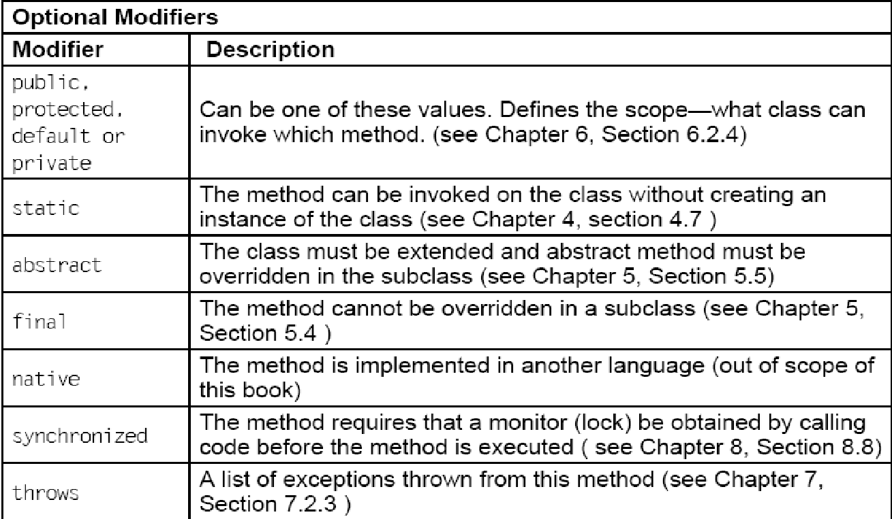
Optional Modifiers Used with Methods

Slide 22
Method (contd.)
Return Type:
can be either void or if a value is returned, it can be either a primitive type or a class.
If the method declares a return type, then before it exits it must have a return statement.
Method Name:
The method name must be a valid Java identifier, as discussed in chapter 3.
Parameter List:
contains zero or more type/identifier pairs make up the parameter list.
Each parameter in parameter list is separated by a comma.

Slide 23
Method (contd.)
Curly Braces:
The method body is contained in a set of curly braces (opening ‘{‘ and closing ‘}’).

Slide 24
Method Example
class Circle {
float pi = 3.14f;
float radius;
void setRadius(float rad) {
radius = rad;}
float calculateArea() {
float area = pi* radius*radius;
return (area);
} }

Slide 25
Method invocation
Methods cannot run on their own, they need to be invoked by the objects they are a part of.
When an object calls a method, it can pass on certain values to the methods (if methods accept them)
The methods can also return values from themselves if they wish to.
Data that are passed to a method are known as arguments or parameters;

Slide 26
Method Invocation
You must also know about different types of parameters:
Formal Parameters: the identifier used in a method to stand for the value that is passed into the method by a caller
Actual Parameters: The actual value that is passed into the method by a caller
The number and type of the actual and formal parameters should be same for a method.
In Java, all values are passed by value. This is unlike some other programming languages that allow pointers to memory addresses to be passed into methods.

Slide 27
Method Invocation
class CallMethod {
public static void main (String args[]) {
float area1;
Circle circleobj = new Circle();
circleobj.setRadius(3.0f);
area1 = circleobj.calculateArea();
System.out.println("Area of Circle = " + area1);
}}

Slide 28
Method Overloading
In method overloading two methods can have the same name but different signature i.e. different number or type of parameters.
The concept is advantageous where same kind of activities are to be performed but with different input parameters

Slide 29
Method Overloading Example
class OverloadDemo {
void max(float a, float b) {
…} //takes care of which number (float) is greater
void max(int a, int b) {
...} //takes care of which number (int) is greater
public static void main(String args[]) {
OverloadDemo o=new OverloadDemo();
o.max(23L,12L);
o.max(2,3); } }

Slide 30
Constructors
Java has a mechanism, known as constructor, for automatically initializing the values for an object, as soon as the object is created.
Constructors have the same name as the class it resides in and is syntactically similar to a method.
It is automatically called immediatey after the object for the class is created by new operator.
Contructors have no return type, not even void, as the implicit return type of a class’ constructor is the class type itself.
Types of Constructors: Implicit/Default, Explicit, Parameterized

Slide 31
Explicit Constructor Example
class Room{
double length, breadth, height, volume;
Room( ) {
length = 14;
breadth = 12;
height = 10; }
double volComp( ) {
volume = length * breadth * height;
return volume; }

Slide 32
Example (contd.)
public static void main (String args[ ]) {
Room r1 = new Room();
Room r2 = new Room();
System.out.println("The volume of the room is "+r1.volComp( ));
System.out.println("The volume of the room is "+r2.volComp( ));
}

Slide 33
Parameterized Constructor Example
class Room2{
double length, breadth, height, volume;
Room2( double l, double b, double h) {
length = l;
breadth = b;
height = h; }
// Computation of volume of the room
double volComp( ) {
volume = length * breadth * height;
return volume; }

Slide 34
Example (contd.)
public static void main (String args[ ]) {
Room2 r1 = new Room2(14, 12, 10 );
Room2 r2 = new Room2(16, 15, 11 );
System.out.println("The volume of the room is "+r1.volComp( ));
System.out.println("The volume of the room is "+r2.volComp( ));
} }

Slide 35
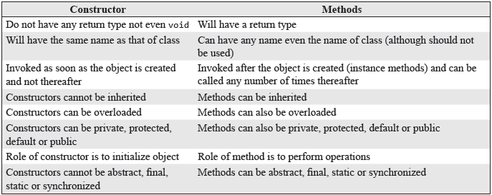
Constructor Vs Methods

Slide 36
Constructor Overloading
Constructors for a class have the same name as the class but they can have different signature i.e. different types of arguments or different number of arguments. Such constructors can be termed as overloaded constructors.
In the example given on next slide, we have two different classes, Rectangle and ConstOverloading. Rectangle class has two constructors, both with same names but different signatures. Second class ConstOverloading, has the main( ) method inside it.

Slide 37
Constructor Overloading Example
class Rectangle{
int l, b;
Rectangle(){
l = 10;
b = 20;
}
Rectangle(int x, int y){
l = x;
b = y;
}
int area() {
return l*b;
}}

Slide 38
Constructor Overloading Example…..
class ConstOverloading {
public static void main(String args[]) {
Rectangle rectangle1=new Rectangle();
System.out.println("The area of a rectangle using first constructor is: "+rectangle1.area());
Rectangle rectangle2=new Rectangle(4,5);
System.out.println("The area of a rectangle using second constructor is: "+rectangle2.area();
} }

Slide 39
The Output
The area of a rectangle using first constructor is: 200
The area of a rectangle using second constructor is: 20

Slide 40
this keyword
The keyword “this” is used in an instance method to refer to the object that contains the method, i.e. the it refers to the current object.
Whenever and wherever, a reference to an object of the current class type is required, ‘this’ can be used.
It has two other usages:
Differentiating between instance variables and local variables
Constructor chaining

Slide 41
this keyword (contd.)
To differentaite between Instance variables and local variables
Room2( double l, double b, double h) {
this.length = l;
this.breadth = b;
this.height = h;
}

Slide 42
Constructor chaining
It means a constructor can be called from another constructor.
/*First Const.*/ Room2()
{
// constructor chained
this(14,12,10);
}
/*Second Const.*/ Room2( double l, double b, double h) {
length = l;
breadth = b;
height = h;
}

Slide 43
Cleaning up unused object
Java allows a programmer to create as many objects as he/she wants but frees him/her from worrying about destroying them. The Java runtime environment deletes objects when it determines that they are no longer required.
The Java runtime environment has a garbage collector that periodically frees the memory used by objects that are no longer needed.
Before an object gets garbage collected, the garbage collector gives the object an opportunity to clean up itself through a call to the object's finalize() method. This process is known as finalization.

Slide 44
Garbage Collector
Two basic approaches :
Reference counting and
tracing.
Reference counting maintains a reference count for every object.
It is incremented and decremented as and when the references on objects increase or decrease (leave an object)
When reference count for a particular object is 0, the object can be garbage collected.

Slide 45
Garbage Collector (contd.)
Tracing technique traces the entire set of objects (starting from root) and all objects having reference on them are marked in some way.
a.k.a mark and sweep garbage
The objects that are not marked (not referenced) are assumed to be garbage and their memory is reclaimed.

Slide 46
Garbage Collector (contd.)
Mark and sweep collectors further use the techniques of Compaction and Copying for fragmentation problems that may arise once you sweep the unreferenced objects.
Compaction moves all the live objects towards one end making the other end a large free space and copying techniques copies all live objects besides each other into a new space and the old space is considered free now.

Slide 47
Advantages
Free From worrying about deallocation of memory
helps in ensuring integrity of programs.
no way by which Java programmers can knowingly or unknowingly free memory incorrectly.

Slide 48
Disadvantages
overhead to keep track of which objects are being referenced by the executing program and which are not being referenced
overhead is also incurred on finalization and freeing memory of the unreferenced objects.
These activities will incur more CPU time than would have been incurred if the programmers would have explicitly deallocated memory.

Slide 49
Your turn
What is Method Overloading?
What is a constructor?
Why do we overload constructors?
Explain the use of this keyword?
What is Garbage collection?

Slide 50
static keyword
Different objects, variables and methods will occupy different areas of memory when created/called. Sometimes we would like to have multiple objects, share variables or methods. The static keyword effectively does this for us.
Static keyword can be applied to variables/methods and blocks of code.
Java supports three types of variables: Local, Instance and Class variables
Local variables are declared inside a method, constructor, or a block of code
Instance variable are declared inside a class, but outside a method

Slide 51
static keyword (contd.)
Class/static variables declaration is preceded with a static keyword. They are also declared inside a class, but outside a method. The most important point about static variables is that there exists only one a single copy of static variables per class.
The effect of doing this is that when we create multiple objects of that class, every object shares the static variable i.e. there is only one copy of the variable declared as static. We can declare a variables as static as under:
static int var = 0;

Slide 52
Instance Variables vs. Class Variables
All instances of the class share the static variables of the class.
A class variable can be accessed directly with the class name, without the need to create an instance.
Without the static keyword, it's called “instance variable”, and each instance of the class has its own copy of the variable.

Slide 53
static methods
Like static variables, we do not need to create an object to call our static method. Simply using the class name will suffice.
Static methods however can only access static variables directly.
Variables that have not been declared static cannot be accessed by the static method directly, i.e. the reason why we create an object of the class within the main (which is static) method to access the instance variables and call instance methods.
To make a method static, we simply precede the method declaration with the static keyword.

Slide 54
static methods
static void aMethod(int param1) {
.....
.....
}
When we declare a method static, we are basically saying that there should only be one instance of this method within our program (e.g, as in the main method)
Methods can also be declared with the static keyword.
static int computeArea(int length, int width) { }

Slide 55
Example
class Area {
static int area; // class variable
static int computeArea (int width, int height) {
area = width * height;
return area;
} }
class callArea {
public static void main(String args[]) {
System.out.println(Area.computeArea(4,3);
} }

Slide 56
static initialization block
A block of statements with static keyword applied to it.
used for initializing static or class variables.
in case some logic is used for assigning values to the variables, static blocks can be used.
The syntax for static block is as follows:
static{
...
}

Slide 57
static initialization block
The static executes as soon as the class loads even before the JVM executes the main method.
There can be any number of static blocks within the class and they will be executed in the order in which they have appeared in the source code.

Slide 58
Instance initialization block
In case the static keyword is dropped from this block, it becomes an instance initialization block
Actually the code of instance initialization block is placed in the <init> method, which is created for every constructor by the compiler, before the source code mentioned by programmer in the constructor.

Slide 59
Static and instance block example
class StaticBlockDemo {
int x=10;
static {
int z=10; // local variable
System.out.println(“In static block”); }
{
System.out.println(“In Instance Initialization block”);
System.out.println(“Printing Instance variable
Initializer value through Block: “ +x);
}

Slide 60
Static and instance block example
// Constructor
StaticBlockDemo(int y) {
System.out.println(“Within Constructor”);
System.out.println(“Instance variable printed
using constructor: “+x);
x=y;
System.out.println(“Instance variable
initialized using constructor: “+x);
}

Slide 61
Static and instance block example
StaticBlockDemo() {
System.out.println(“Within Constructor”);
System.out.println(“Instance variable printed using
constructor: “+x); }
public static void main(String[] args) {
System.out.println(“In main”);
StaticBlockDemo st = new StaticBlockDemo(100);
System.out.println(“------------------------------------------ ”);
StaticBlockDemo st1 = new StaticBlockDemo();
} }

Slide 62
The Output
In static block
In main
In Instance Initialization block
Printing Instance variable Initializer value through Block: 10
Within Constructor
Instance variable printed using constructor: 10
Instance variable initialized using constructor: 100
------------------------------------------
In Instance Initialization block
Printing Instance variable Initializer value through Block: 10
Within Constructor
Instance variable printed using constructor: 10

Slide 63
Array
There are situations where we might wish to store a group of similar type of values in a variable.
Array is a memory space allocated, which can store multiple values of same data type, in contiguous locations.
This memory space, which can be perceived to have many logical contiguous locations, can be accessed with a common name.

Slide 64
Array (contd.)
A specific element in an array is accessed by the use of a subscript or index used in brackets, along with the name of the array.
For example, marks[5]would mean marks of 5th student.
While the complete set of values is called an array, the individual values are known as elements.
Arrays can be two types:
one dimensional array
multi-dimensional array

Slide 65
1-D Arrays
In one-dimensional array, a single subscript or index is used, where each index value refers to individual array element.
The indexation will start from 0 and will go up to n-1, i.e. the first value of the array will have an index of 0 and the last value will have an index of n–1, where ŋ is the number of elements in the array.
So, if an array named marks has been declared to store the marks of 5 students, the computer reserves five contiguous locations in the memory, as shown below

Slide 66
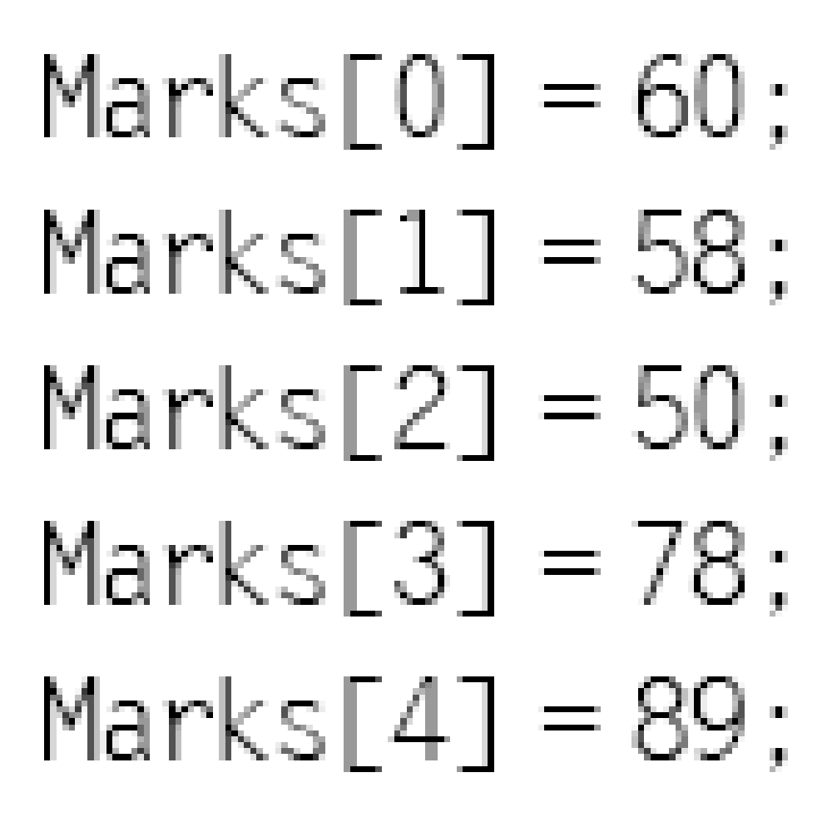
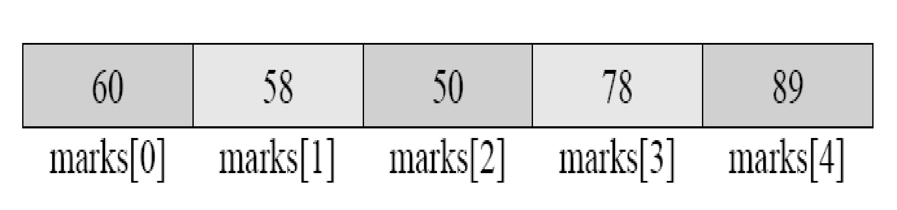
1-D Array

Slide 67
Creation of Arrays
Creating an array, similar to an object creation, can inherently involve three steps:
Declaring an array
Creating memory locations
Initializing/assigning values to an array

Slide 68
Declaring an array
Declaring an array is same as declaring a normal variable except that you must use a set of square brackets with the variable type.
There can betwo ways in which an array can be declared.
type arrayname[ ];
type[ ] arrayname;
For e.g.
int marks[ ]; or
int[ ] marks;

Slide 69
Creating memory locations
An array is more complex than a normal variable, so we have to assign memory to the array when we declare it.
You assign memory to an array by specifying its size. Interestingly, our same old new operator helps in doing the job, just as shown below:
Arrayname = new type [size];
So, allocating space and size for the array named as marks can be done as,
marks = new int[5];

Slide 70
initializing/assigning values to an array
Assignment of values to an array, which can also be termed as initialization of array, can be done as follows,
Arrayname[index] = value;
The creation of list of marks to be assigned in array, named as marks has already been shown in the section above. Here is an example of how to set the values for an array of 5 marks.

Slide 71
Setting Values in An Array
public class Array {
public static void main(String[] args) {
int[] marks = new int[5];
marks[0] = 60;
marks[1] = 58;
marks[2] = 50;
marks[3] = 78;
marks[4] = 89;
} }
Alternatively you can also use:
int marks[] = {60, 58, 50, 78, 89}

Slide 72
Sorting Arrays (SortArray.java)
class SortArray {
public static void main(String[] args) {
int[] marks = {3, 5, 1, 2, 4};
int temp, n;
n = marks.length;
System.out.print("The list of marks is: ");
for(int i = 0; i< n; i++){
System.out.print(marks[i]+ " "); }
for (int i = 0; i< n; i++){
for (int j = i+1; j < n; j++){
if (marks[i] < marks[j]) {
temp = marks[i];
marks[i] = marks[j];
marks[j] = temp; }}}
System.out.print("\nList of marks sorted in descending order is: ");
for (int i = 0; i< n; i++){
System.out.print(marks[i]+" "); } } }

Slide 73
2-D Arrays (contd.)
A two-dimensional array can have values that go not only across but also across.
Sometimes values can be conceptualized in the form of table that is in the form of rows and columns.
Suppose we want to store the marks of different subjects. We can store it in a one-dimensional array.

Slide 74
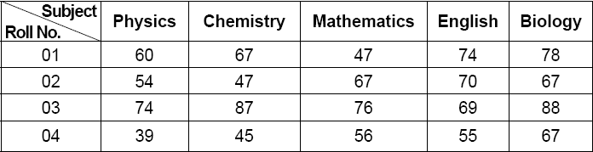
2-D Arrays (contd.)

Slide 75
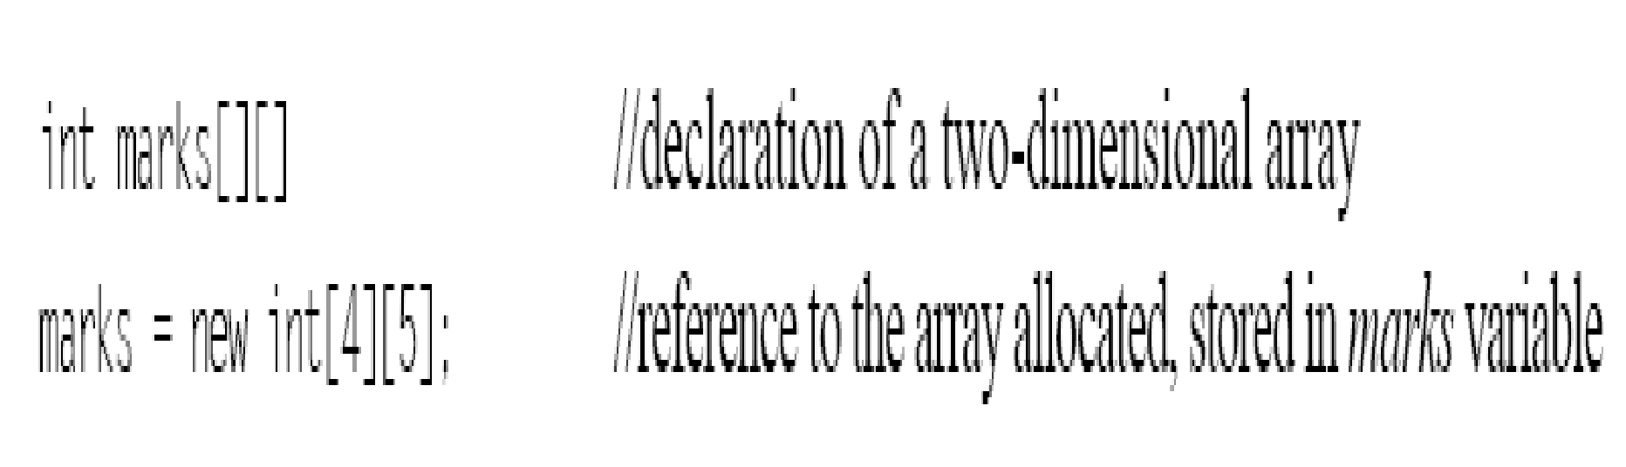
2 D Arrays (contd.)
If you want a multidimensional array, the additional index has to be specified using another set of square brackets.
Following statements create a two-dimensional array, named as marks, which would have 4 rows and 5 columns

Slide 76
2 D Arrays (contd.)
This statement just allocates a 4 × 5 array and assigns the reference to array variable marks.
The first subscript inside the square bracket signifies the number of rows in the table or matrix and the second subscript stands for the number of columns.
This 4 × 5 table can store 20 values altogether.
Its values might be stored in contiguous locations in the memory, but logically, the stored values would be treated as if they are stored in a 4 × 5 matrix.
The following table shows how the marks array is conceptually placed in the memory by the above array creation statement

Slide 77
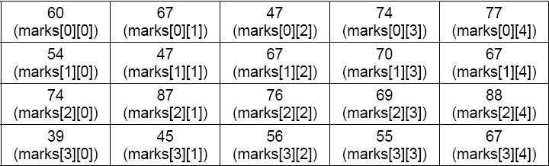
2 D Arrays (contd.)

Slide 78
2 D Arrays (contd.)
Like a one-dimensional array, two-dimensional array may be initialized with values, at the time its creation. For example,
int marks[2][4] = {2, 3, 6, 0, 9, 3, 3, 2};
This declaration shows that the first two rows of a 2 × 4 matrix have been initialized by the values shown in the list above. It can also be written as,
int marks[ ][ ] = {(2, 3, 6, 0), (9, 3, 3, 2)};

Slide 79
Example
class MatrixMul {
public static void main(String args[]) {
int array[][] = {{3,7},{6,9}};
int array1[][] = {{5,4},{3,6}};
int array2[][] = new int[2][2];
int x = array.length;
System.out.println("Matrix 1: ");
for (int i=0; i<array.length; i++) {
for (int j=0; j<array[i].length; j++) {
System.out.print(" "+array[i][j]);
}
System.out.println();
}

Slide 80
Example (contd.)
int y = array1.length;
System.out.println("Matrix 2: ");
for (int i=0; i<array1.length; i++) {
for (int j=0; j<array1[i].length; j++) {
System.out.print(" "+array1[i][j]); }
System.out.println(); }
for (int i=0; i<x; i++) {
for (int j=0; j<y; j++) {
for(int k=0; k<y; k++) {
array2[i][j] += array[i][k]*array1[k][j]; } } }
System.out.println("Multiplication of both matrices: ");

Slide 81
Example (contd.)
for (int i=0; i<x; i++) {
for (int j=0; j<y; j++) {
System.out.print(" "+array2[i][j]); }
System.out.println();
}}}

Slide 82
Passing Arrays to Methods
static void show(int[][] a){
for(int i=0;i<a.length;i++){
for(int j=0;j<2;j++){
System.out.print(" " +a[i][j]);
}
System.out.println();
} }

Slide 83
Returning Arrays from Methods
static int[][] show()
{
int a[][]={{1,2},{2,3}};
return a;
}

Slide 84
Using for-each with arrays
The enhanced for loop, i.e. for-each was introduced in Java 5 to enhance iterations over arrays and other collections easier. The format of for-each is as follows:
for (type var : arr){
// Body of loop
}

Slide 85
Using for-each with arrays
For example, to calculate the sum of the elements of the array, for-each can be used as follows.
int[] arr= {2,3,4,5,6};
int sum = 0;
for( int a : arr)
// a gets successively each value in arr
{
sum += a;
}
The disadvantage of for-each approach is that it is possible to iterate in forward directiononly by single steps.

Slide 86
Variable Arguments
Variable arguments can be used when the number of arguments that you want to pass to a method are not fixed.
The method can accept different number of arguments of same type whenever they are called.
The generic syntax for this notation is:
returntype methodName(datatype...arrayname)

Slide 87
Variable Arguments (contd.)
static void add(int...a)
{
int sum=0;
for(int i=0;i<a.length;i++)
sum=sum+a[i];
System.out.println("SUM = "+sum);
}
Can be invoked as
add(2,3,4,5) Or add(2,3,4);

Slide 88
Command Line Arguments
Suppose, you have a Java application, called sort, that sorts the lines in a file named Sort.text. You would invoke the Sort application as,
java Sort Example.txt
When the application is invoked, the runtime system passes the command line arguments to the applications main( ) method via an array of string.
In the statement above, command line arguments (Example.txt) is passed to the Sort application an array of String that contains a single string, i.e. Example.txt.
This String array is passed to the main method and it is copied in args.
public static void main (String args[]) {
. . . . . .
} // end of the main( ) method

Slide 89
Command Line Arguments
In this case, each of the elements in the array named args (including the elements at position zero) is a reference to one of the command line arguments, each of which is a string object.
The number of elements in an array can be obtained from the length property of the array.
Therefore in the signature of main( ), it is not necessary in Java to pass a parameter specifying the number of arguments.

Slide 90
Example
class Echo {
public static void main(String args[]) {
int x = args.length;
for (int i = 0; i < x; i++)
System.out.println(args[i]);
} }
After compiling the program, when it is executed, you can pass the command line arguments as follows,
C>java Echo A B C

Slide 91
The output
A
B
C
If the command
c:\java Echo “A is first alphabet” “B is second” “C is third” is invoked
The output is as follows:
A is first alphabet
B is second
C is third

Slide 92
Your Turn
what is difference between local, instance and class variable?
What is the difference between static and instance initialization block?
How are arrays created in java?
What are variable arguments
What are command line arguments?

Slide 93
Nested Classes
Nested class is a class within a class. Nested classes are of the following types:
Non-static inner classes
Static nested classes
Local classes
Anonymous Inner classes

Slide 94
Why do we Create Nested Classes?
let you turn logic into their own classes which normally you would not turn into thus allowing even more object orientation into your programming.
lets you encapsulate logic into classes.
Inner classes provide a structured hierarchy.
allow callbacks to be defined conveniently.
Callback allows an object to call back the originating object at a later point in time.

Slide 95
Why Nested classes
very effective in implementing event handling in Java.
Another advantage of nested classes would be to group classes that would be required at one place only.
If you are certain that a class will be useful to only one class then it is better to embed a class into another.
The obvious advantages would be ease of readability and ease of maintaining the code.

Slide 96
Non static inner class
is a member of the outer class declared outside the functions within a class.
bound to the instance of the enclosing class
has access to all the members of the enclosing class even the parent’s this reference and private members.
can be defined as private, default, protected, public, final and even abstract.

Slide 97
Non static Inner class
inner class instance has a reference to an enclosing outer instance.
A reference to the outer class instance can be obtained through OuterClassName.this
cannot have static variables or methods except for compile-time constant variables, i.e., static constant.
Inner class’s objects can be created within instance methods, constructors of the outer class or through an instance of outer class

Slide 98
Inner class Example
class InnerClassTest
{
int y=20; // instance variable of outer class
static int a=30; // class variable of outer class
class InnerClass // inner class begins
{
int x=10;
final static int z=50;
void show() {
System.out.println("Within Non static Inner Class");

Slide 99
Inner class Example
System.out.println("Can Access Inner class variable "+x);
System.out.println("Can Access Outer class variables "+y);
System.out.println("Can Access Outer class static variables "+a);
System.out.println("Inner class instance accessed using this:"+this);
System.out.println("Outer class referred from inner class using InnerClassTest.this: "+ InnerClassTest.this);
outerInstanceMethod();
outerClassMethod();
}

Slide 100
Inner class Example
void outerInstanceMethod() {
System.out.println("Outerclass Instance method called from Inner class"); }
static void outerClassMethod() {
System.out.println("Outerclass static method Called from Inner class"); }
void createInnerObject() {
new InnerClass().show(); }
public static void main(String args[]) {
InnerClassTest object = new InnerClassTest();
object.createInnerObject();
//Another way: object.newInnerClass().show(); } }

Slide 101
The Output
Within Non static Inner Class
Can Access Inner class variable 10
Can Access Outer class variables 20
Can Access Outer class static variables 30
Inner class instance accessed using this: InnerClassTest$InnerClass@f72617
Outer class referred from inner class using InnerClassTest.this:
InnerClassTest@1e5e2c3
Outerclass Instance method Called from Inner class
Outerclass static method Called from Inner class

Slide 102
Static Nested class
is a static member of a class just like normal static members of any class.
have access to all static methods of the enclosing parent class.
cannot directly refer to instance variables and method of the outer class, similar to static parts of any class; access it through an object of the outer class.
Unlike the inner classes, the static nested classes can have static members.

Slide 103
Static Nested class Example
class StaticNestedClassTest {
int y; // instance variable
static int z=100; // class variable
static class StaticNestedClass {
int x;
static int staticinner=200;
void nestedClassNonStaticMethod() {
// y cannot be referenced here
System.out.println("Accessing static variable of outer class within Static Inner Class "+z);
//outerClassInstanceMethod();
outerClassStaticMethod(); }

Slide 104
Static Nested classes Example
static void nestedClassStaticMethod() {
System.out.println("Within Static method of Inner Class ");
//outerClassInstanceMethod();
outerClassStaticMethod();}
} // static nested class ends here
static void outerClassStaticMethod(){
System.out.println("Outer Class Static method");}
void outerClassInstanceMethod(){
System.out.println("Outer Class Instance method"); }

Slide 105
Static Nested class Example
public static void main(String args[])
{
StaticNestedClassTest.StaticNestedClass object = new
StaticNestedClassTest.StaticNestedClass();
object.nestedClassNonStaticMethod();
object.nestedClassStaticMethod();
}
}

Slide 106
The Output
D:\javabook\programs\chap 4>java StaticNestedClassTest
Accessing static variable of outer class within Static Inner Class 100
Outer Class Static method
Within Static method of Inner Class
Outer Class Static method

Slide 107
Local & Anonymous classes
Local inner classes are declared within a block of code and are visible only within that block, just as any other method variable.
These classes are declared within a function. They can use only final (constant) local variables and parameters of the function
An anonymous inner class is a local class that has no name.
They are extensively used in Event Handling

Slide 108
Summary
A class provides a sort of template or blueprint for an object.
An object is a software bundle which encapsulates variables and methods, operating on those variables.
A Java object is defined as an instance of a class.
A class can have many instances of objects, each having its own copy of variable and methods. The variables declared inside a class (but outside a method) are termed as instance variable. Attributes of a class are defined by instance variables, while its behavior is defined by methods.

Slide 109
Summary (contd.)
These methods, declared as part of one object can be invoked or called from another object. The method or variable belonging to a particular can be accessed by specifying the name of the object to which they belong to.
A special type of variable, whose value remains the same through out all the objects of a class, is known as class or static variable. Likewise a method can also be declared as static, which exist within the one location in memory no matter how many times it is called from multiple objects. Both static variable and static method can be called directly from anywhere inside a class, without specifying any object name.
In java the objects are automatically freed after their use. The garbage collector periodically frees the memory used by objects that are no longer needed

Slide 110
Summary (contd.)
Method Overloading and overriding are two ways of implementing polymorphism in java.
Command Line Arguments is a way fo passing input to Java programs.
Arrays are used to hold to hold data of similar type. There can be of 1-dimensional or multidimensional arrays.
Nested classes are classes within class. They can be static, non-static, local and anonymous.

